Slide 1


BUSINESS
REPORT
by Minh Tri Doan

Slide 2
Main goals:
Identify main market
Who are our valuable customers
Which products are “cash cow”
What this report covers
Company Overview
Highlight and key updates
Prediction
Agenda

Slide 3

Company
Overview
UK-based and registered non-store online retail
Occasion gifts
Wholesalers.
Dataset:
All transactions
01/12/2010 - 09/12/2011

Slide 4

Highlights and Key Updates
88.8 % customers live in UK
Identify our playground, answer “Which market should we target”
Most transactions occurred from 10pm – 2pm on weekdays, mostly from Sep to Dec
Answer “Which time did we get more sale”, “When will we need discount”
Light Holders, Cakestand 3 Tier and Retrospots are main products
Answer “Which products are our cash cow”

Slide 5

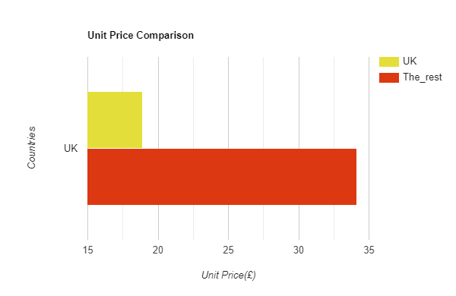
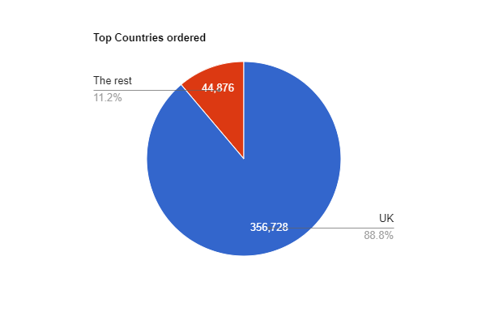
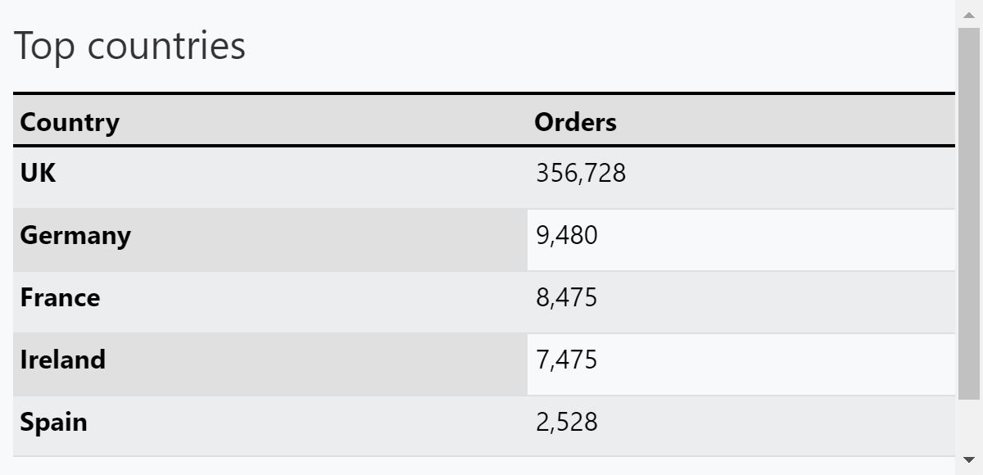
Customer analysis
Notes:
Where are our customers from ?
UK order 356,728 orders in 401,604 orders in total, in 37 countries
The rest countries: potential, especially Ireland and Netherlands, there are 2 customers with top 2 orders and highest spending
How much did they buy in average?
On average, UK bring less revenue: roughly 19 pound. While other countries bring roughly 34 pound per customers

Slide 6
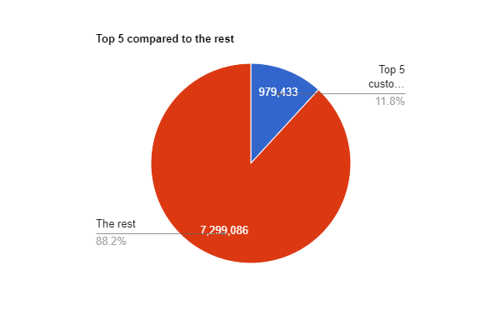
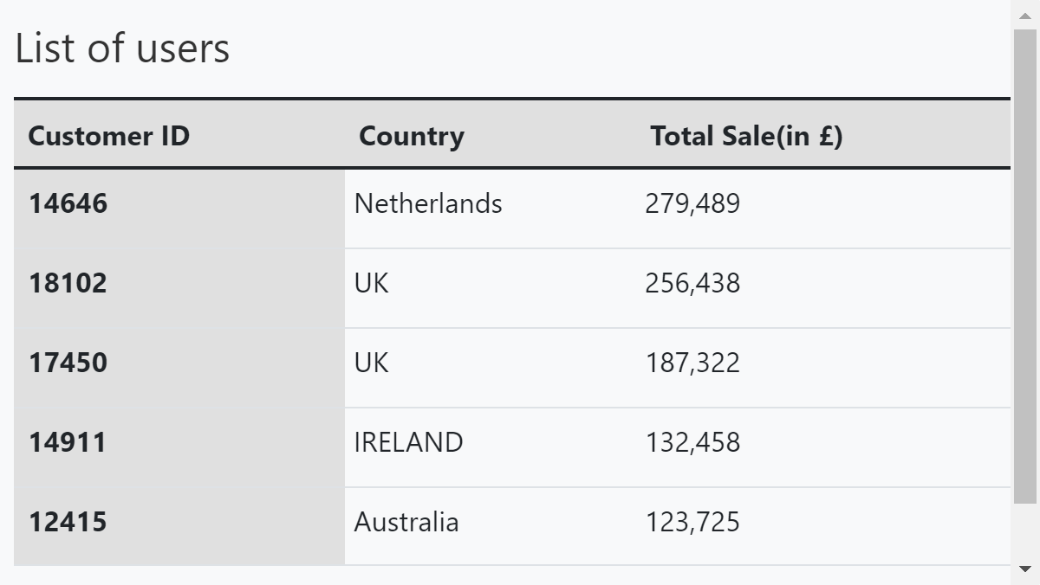
Who are biggest spenders?
Notes:
5 in 4380 customers, counted nearly 12% our sales

Slide 7
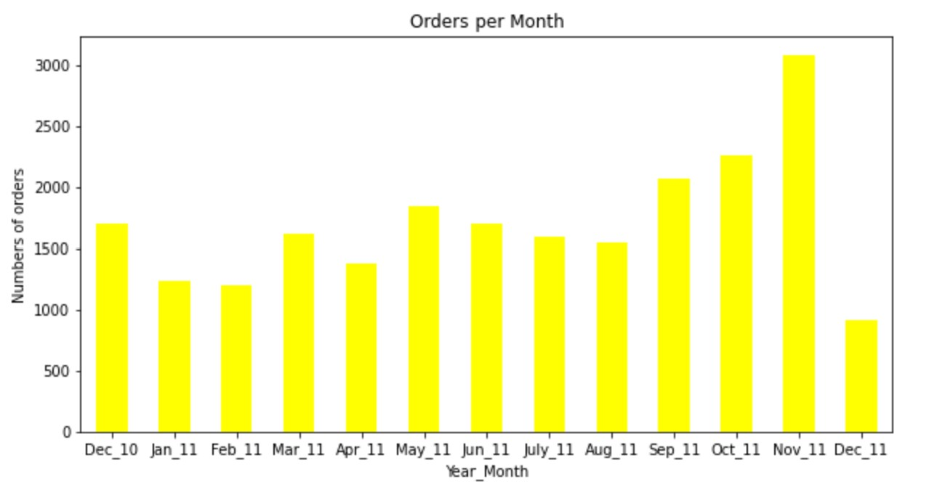


Which time ?
Per month/Per day/ Per hour
Sep-Dec: good time to sell

Slide 8
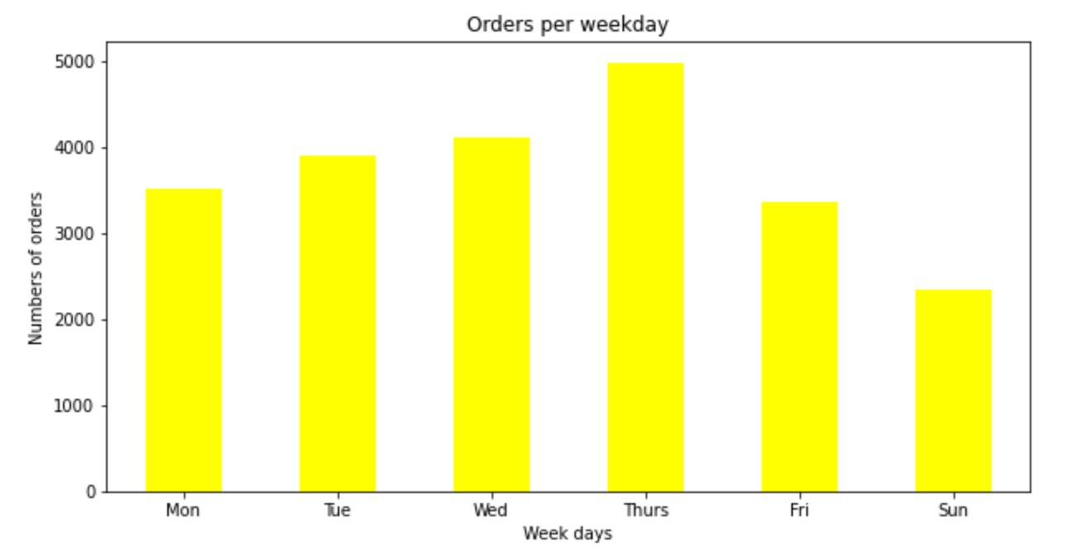
Which time ?
Per month/Per day/ Per hour
Sep-Dec: good time to sell
Weekday: get more orders than weekend
Notes:
No data for Saturday

Slide 9
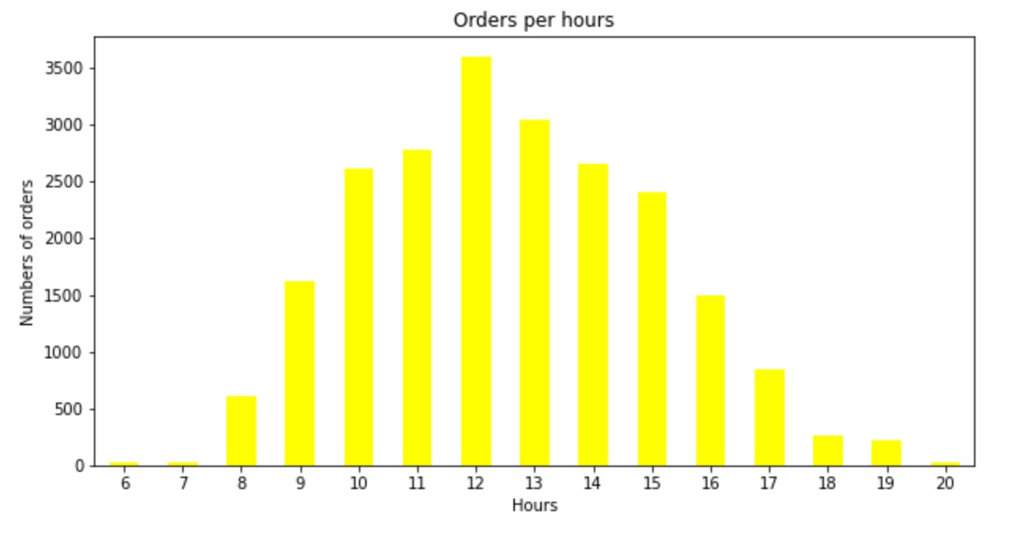
Which time ?
Per month/Per day/ Per hour
Sep-Dec: good time to sell
Weekday: get more orders than weekend
10AM – 2PM: more customers
Notes:
No data for Saturday

Slide 10
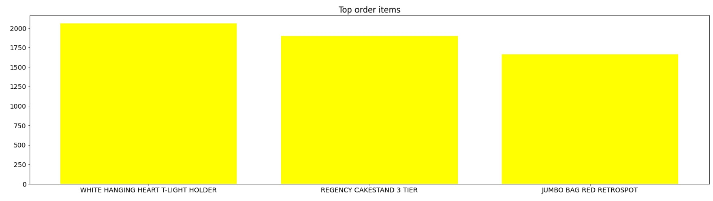
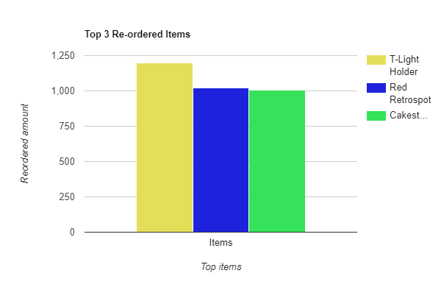
Which products ?
Notes:
In 3896 items, these are top 3 items:
How much revenue they bring ?
Holder: 15.3 * 2058 = 93767
Cakestand = 132567
Retrospot = 83,056
=> Nearly 310k Pound
=> Counted nearly 4% in total revenue
But why they are our cash cow ? => Re-ordered items

Slide 11
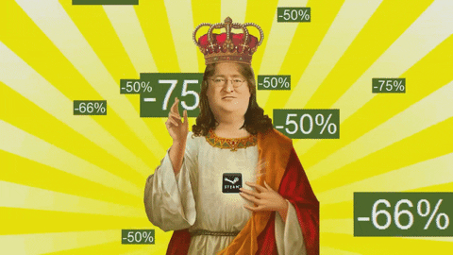


Action
Personalization our value customers
Make them feel valued by:
Offer personal discount
Upsell and cross-sell by purchase history
Personalized email: special date,..
Focus on cash-cow and reduce abandoned carts
4% good ? Yes and No
Notes:
1. Make it personal -> personalization -> increase rentention
treat them as an individual and make them feel valued
Offer personal discount
remember customer history: showcase list of recommendation -> upsel and crossell
Personalized email
2. Reduced abandoned carts
-> learn what are the obstacles for them not to buy
-> adjust marketing strategy: discount on weekday, from 11pm – 2pm to push sale.

Slide 12
Sale prediction model
Personalization our value customers
Make them feel valued by:
Offer personal discount
Upsell and cross-sell by purchase history
Personalized email: special date,..
Focus on cash-cow and reduce abandoned carts
4% good ? Yes and No
Notes:
1. Make it personal -> personalization -> increase rentention
treat them as an individual and make them feel valued
Offer personal discount
remember customer history: showcase list of recommendation -> upsel and crossell
Personalized email
2. Reduced abandoned carts
-> learn what are the obstacles for them not to buy
-> adjust marketing strategy: discount on weekday, from 11pm – 2pm to push sale.

Slide 13

Thank you!

